Slide 1
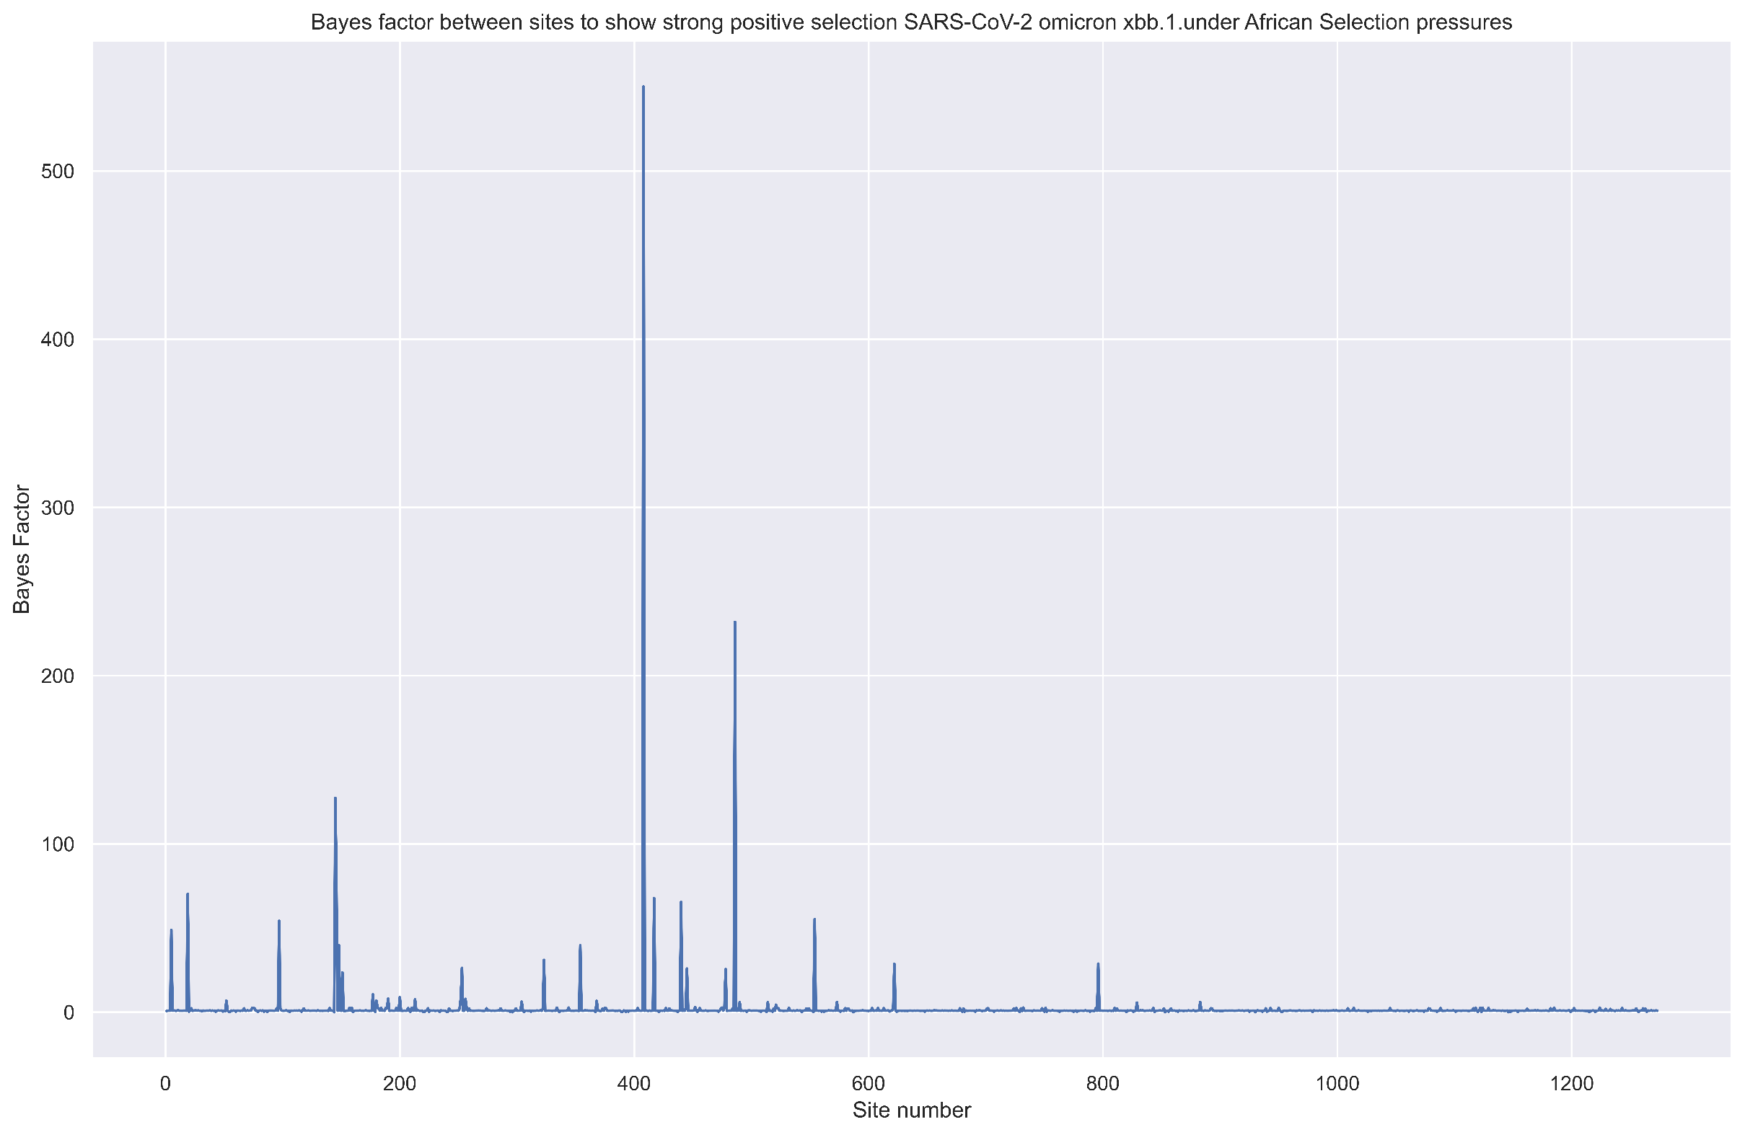
N-Terminal Domain
Receptor-binding domain
SD1/ SD2
S1 Subunit
S1/S2 cleavage site
S2 Subunit

Slide 2
